Slide 1
Environmental Prop Modeler
Christopher Ramzi

Slide 2
Project
Modeling Props
Make cohesive scene
1 prop per week
Or
2-3 smaller props per week

Slide 3
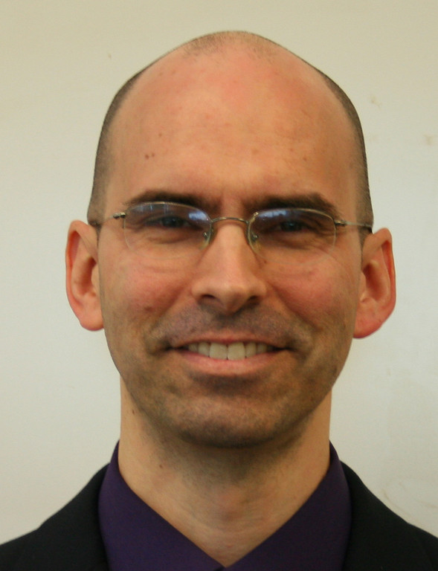
Mentor

Slide 4
How
Using
Maya
Substance Painter
Blender
Mudbox
Focusing on low poly
w/ High poly normal

Slide 5


Goals
Be able to upload it for my portfolio
Create a scene that works well together

Slide 6
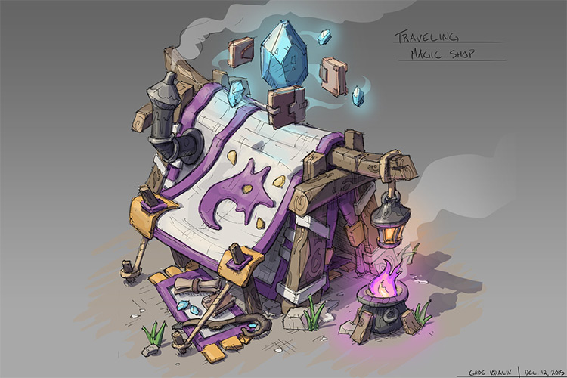
Ideas

Slide 7
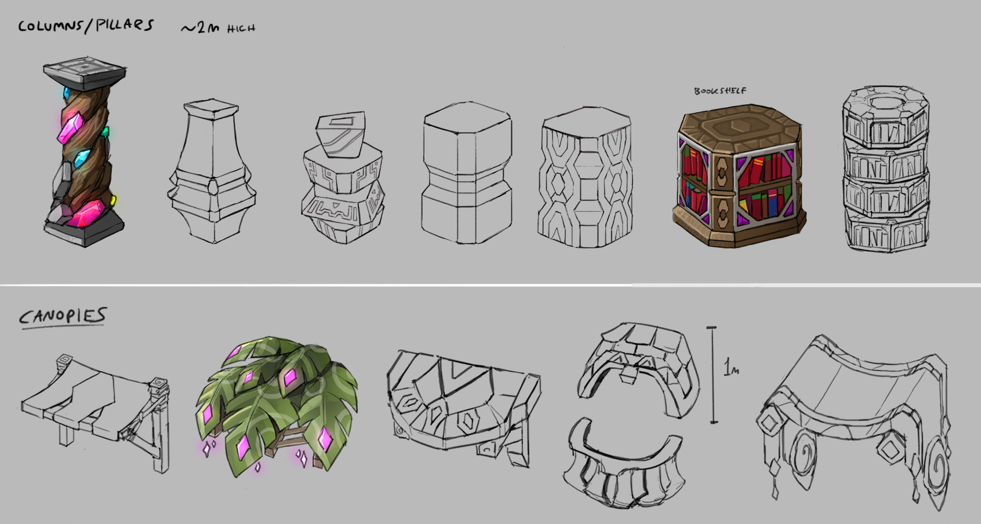
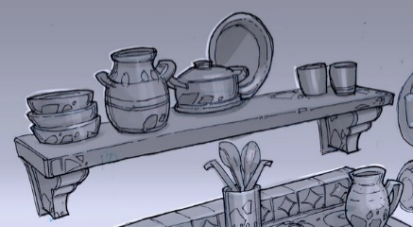
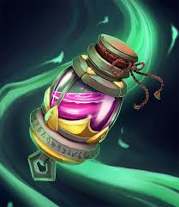
Items ideas

